Slide 1

Penetration Testing Methodology and Policy
Justin Keith

Slide 2
Introduction
DoD used penetration testing in the 1970s
Must be used in a well-planned and professional approach
Establishment of CIA for authorized users may not ensure legal requirements
Security breaches may occur from internal sources

Slide 3
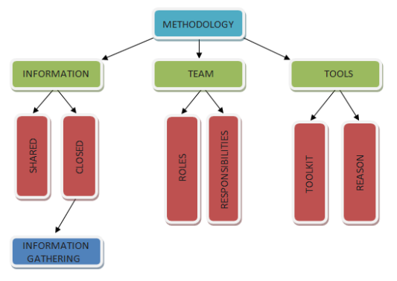
Sample methodology

Slide 4
Phases of information gathering
Phase 1
Information gathering
Phase 2
OS identification
Phase 3
Port scanning
Phase 4
Services identification
Notes:
1/ Network survey/network map
2/ TCP/IP stack fingerprinting probing a system for responses OS and version level
OS type
System type
Internal system net addressing
Nmap
3/ Not all ports need tested 2^16 ports
List of all open ports
Ip of live systems
Internal system network addressing
Discovered tunneled and encapsulated prots
-routing protocols supported

Slide 5
Sample methodology

Slide 6
Team building
Penetration testing is best done in teams
Specified roles
Little-to-no crossover in roles

Slide 7
Sample methodology

Slide 8
Results of no methodology
Incomplete testing
Time consuming
Waste of effort
Ineffective testing
Notes:
Inc/ not fulfil requirements
Time/ re-ordering of final report format
Waste/ repeated testing
Ineffective/ results and reporting don’t meet client needs

Slide 9
Penetration Testing Policy
Pen-testers should be aware of scope and range
Gathering of all information and reported within defined boundaries
Timing table of penetration tests
Pen-tester held responsible
Company responsible
Confidentiality of test
Notes:
1 – accuracy confidentiality and resource savings
2 – Privacy
3 – Safety so tests don’t interfere with the working system
4 & 5 damages agreed upon
6 – contract details and system failures

Slide 10
Penetration Testing Policy
Pen-tester can sub-contract
Shared confidential information
Confidential information not to be shared with 3rd parties
Time-table for use and access to confidential company data
Real attacks occurring while pen-testing is happening is company’s responsibility
Notes:
1 – third parties don’t need to be signed off on by company but should be held to contractual agreement
2 – Passwords/Emails/accounts
3 – Not sub contractors but other third parties
4 – no further information gathering or testing outside of project scope
5 - ramble

Slide 11
THE END
Questions?

